Slide 1

Movie Success Predictor
Using Deep Learning to Predict IMDB Ratings
By Team 12 Tanvi Saini, Akshay Uchila Navada, Mike Shu, Liuxinhao Gao, Nina Wu

Slide 2
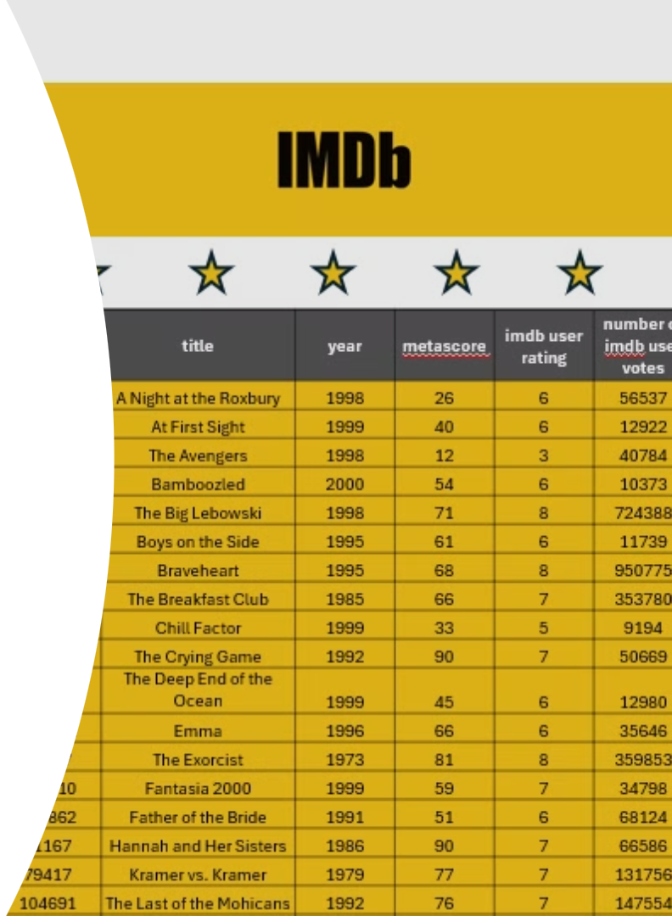





Movie Data Sources and Feature Engineering
Data Source:
imdbid | title | year | metascore | imdb user rating | number of imdb user votes
120770 | A Night at the Roxbury | 1998 | 26 | 6 | 56537
132512 | At First Sight | 1999 | 40 | 6 | 12922
118661 | The Avengers | 1998 | 12 | 3 | 40784
215545 | Bamboozled | 2000 | 54 | 6 | 10373
118715 | The Big Lebowski | 1998 | 71 | 8 | 724388
112571 | Boys on the Side | 1995 | 61 | 6 | 11739
112573 | Braveheart | 1995 | 68 | 8 | 950775
88847 | The Breakfast Club | 1985 | 66 | 7 | 353780
163579 | Chill Factor | 1999 | 33 | 5 | 9194
99291 | Come See the Paradise | 1990 | -1 | 6 | 2549
104036 | The Crying Game | 1992 | 90 | 7 | 50669
120646 | The Deep End of the Ocean | 1999 | 45 | 6 | 12980
116191 | Emma | 1996 | 66 | 6 | 35646
70047 | The Exorcist | 1973 | 81 | 8 | 359853
120910 | Fantasia 2000 | 1999 | 59 | 7 | 34798
101862 | Father of the Bride | 1991 | 51 | 6 | 68124
91167 | Hannah and Her Sisters | 1986 | 90 | 7 | 66586
79417 | Kramer vs. Kramer | 1979 | 77 | 7 | 131756
104691 | The Last of the Mohicans | 1992 | 76 | 7 | 147554
362270 | The Life Aquatic with Steve Zissou | 2004 | 62 | 7 | 178190
104797 | Malcolm X | 1992 | 73 | 7 | 84668
151137 | The Messenger: The Story of Joan of Arc | 1999 | 54 | 6 | 63712
374900 | Napoleon Dynamite | 2004 | 64 | 6 | 196676
109045 | The Adventures of Priscilla, Queen of the Desert | 1994 | 70 | 7 | 46181
120791 | Practical Magic | 1998 | 46 | 6 | 72111
93779 | The Princess Bride | 1987 | 77 | 8 | 390110
100436 | Pump Up the Volume | 1990 | 77 | 7 | 26126
120032 | Romy and Michele's High School Reunion | 1997 | 59 | 6 | 41435
94012 | Spaceballs | 1987 | 46 | 7 | 170647
86373 | Strange Brew | 1983 | 50 | 6 | 15559
88196 | Streetwise | 1984 | -1 | 8 | 1735
51036 | Sweet Smell of Success | 1957 | 100 | 8 | 27733
387131 | The Constant Gardener | 2005 | 82 | 7 | 131294
68646 | The Godfather | 1972 | 100 | 9 | 1596152
71562 | The Godfather: Part II | 1974 | 90 | 9 | 1115042
Movies
2820
Timeline
1913 - 2021
Textual Features
27
Plot Summaries
Key Words
Genres
Categorical Features
Word2vec
Genres
Production Companies
MultiLabelBinarizer

Slide 3
Deep Neural Network Modeling Approach
Model Architecture
Hidden Layers
1
Deep Learning
Input Layer
1829 Features
Layer 1
256 Neurons
ReLU + BatchNorm
We employed a deep neural network architecture to capture complex relationships within the movie data
Layer 2
128 Neurons
ReLU + Dropout (0.6)
2
Regularization
Dropout and batch normalization techniques were implemented to prevent overfitting and enhance model generalization
1 Output
IMDb Rating
Layer 3
64 Neurons
ReLU + Dropout (0.6)
3
Performance Evaluation
Validation sample used to enhance model performance. Evaluation metrics MSE and MER to ensure accuracy

Slide 4


Evaluation Metrics and Model Performance
1
2
MSE
MedER
Our deep learning model outperformed linear regression by achieving a lower MSE, indicating better overall prediction accuracy.
The deep learning model also exhibited a lower MedER, highlighting its ability to provide more accurate predictions for a greater number of movies.
0.1

Slide 5


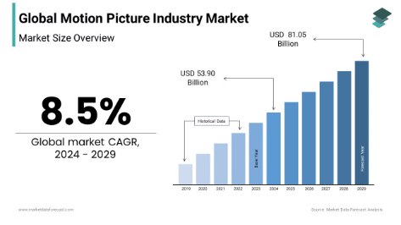



2022 5393
Why this matters?
2023 6120
Increasing Market and Projects
Increasing Market Opportunity
~11,000 movies released globally in 2023
significant 12% increase from 2022
Quick and Effective Project Evaluation is Key to Success
Increasing Projects
2024 6000
30% more projects taken annually
~50,000 screenplays registered in the US alone annually
Expected to increase further with
Source: Market Data Forecast, https://www.marketdataforecast.com/market-reports/motion-picture-industry-market
https://www.screenplaysubmit.com/how-many-screenplays-are-written-and-sold-each-year/?utm_source=chatgpt.com

Slide 6



What we can offer
Productivity Boost
Revenue Growth
Current Issue:
Only ~3
scripts reviewed daily in production house
Faster greenlighting of successful projects
99%
scripts reviewed are rejected
~10-15% more projects
Time Savings with Prioritization Using Our Model:
$10M+ additional annual revenue
Reduced Time on Low-Potential Projects
Potential High Predicted
Success
Save $5M+ in sunken costs from reduced project failures
Potential to save 6-9hrs daily, 1000hrs annually

Slide 7



Predicted Rating for a New Movie
Input
Plot: In a near-future Earth, interdimensional rifts threaten reality, caused by Nexus Prime, a cosmic entity seeking to merge all dimensions into one. A team of heroes from different dimensions must unite to stop the collapse of the multiverse.
Keywords: Superheroes, Multiverse, Teamwork, Epic, Avengers, Betrayal
Genre: Action, Sci-Fi, Superhero, Adventure, Drama
Production: Marvel Studios (Kevin Feige, Sarah Halley Finn)
Predicted
IMDb Rating:
6.95
Source: IMDb, https://www.imdb.com/title/tt0814207/

Slide 8




Future Developments and Directions
Advanced Computational Power
One Stop Solution for Movie Script Analyses
Expanding Predictive Capabilities:
Genre Classification
Character Analysis
Scene-wise Sentiment Analysis
Budget and Revenue Prediction

Slide 9

Thank You!

